Slide 1
Area Detector
July 2026
Kay Kasemir, Klemen Vodopivec
based on presentations by Mark Rivers, APS, U. Chicago

Slide 2
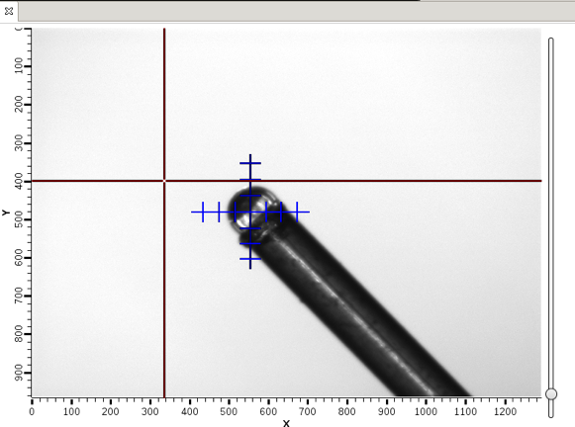
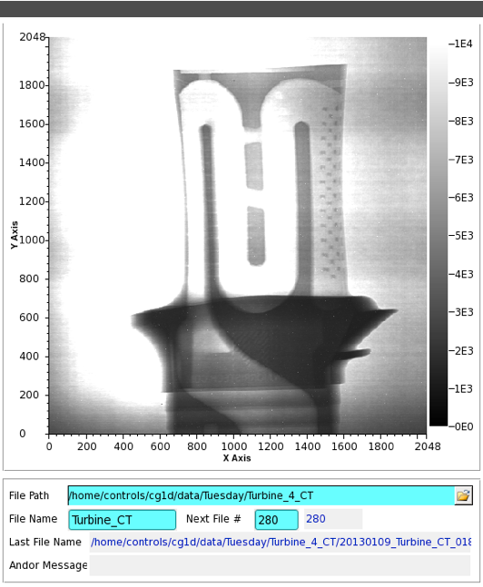
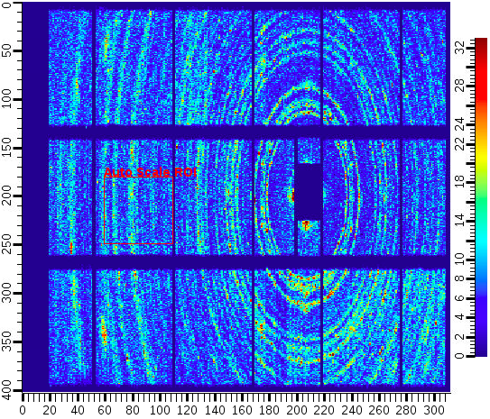
Area Detector
EPICS framework for image manipulation
“Cameras”
  Basic Web Cam
  $$$ high speed, high res.
  Neutron, X-Ray detectors
“Plugins”
  ROI
  Transform
  ColorConvert
  Could add your own

Slide 3
Features
Maybe the largest shared EPICS Application
PVs for image settings, shutter, exposure, …
  “Simulated” area detector IOC has 6000 records
N-D data
  1D: time series data
  2D: images (most common)
  Up to 10D
  Custom metadata
Supports >500 frame/second detectors

Slide 4
Disclaimer
This will only scratch the surface.
EPICS web site has several days of training material if you are serious about using the A.D.

Slide 5
Vocabulary
Driver
  Interface to camera
  Vendor libraries, custom protocols
  Creates NDArray
Plugin
  Manipulates NDArray data
  May change data
  May send data to other plugins
    No-copy if not changed
NDArray
  Structure holding data
  N-dimensional array
    N=2 for basic greyscale image
    N>2 for color, detector with “depth”
NDAttribute
  Metadata attached to NDArray
    Motor position, temperature, shutter,…
  Added by driver, from PVs, Plugins…
NDArrayPool
  Pool of NDArrays to reduce memory allocation

Slide 6
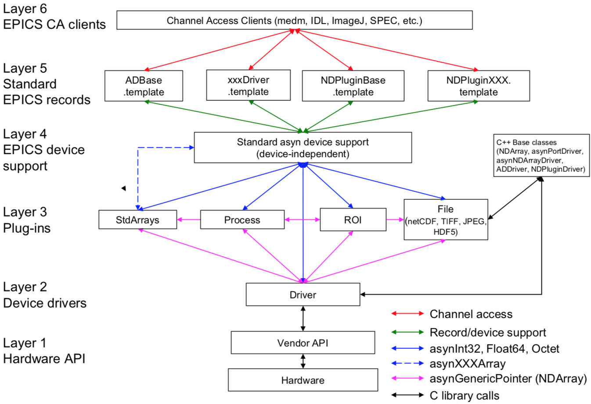
EPICS AreaDetector Architecture

Slide 7
Configurable plugins mechanism
Merges into single channel
Splits series of images into two channels equally
Reads images from camera
FFT
File
Scatter
Gather
Camera
Driver
Transform
(rot90)
FFT
Stats
CPU intensive operation
Rotates images 90deg clockwise
Stats
Legend:
CPU1
CPU2
CPU3
CPU4
--- original data
--- modified data
Provides PVs like min, max intensity

Slide 8
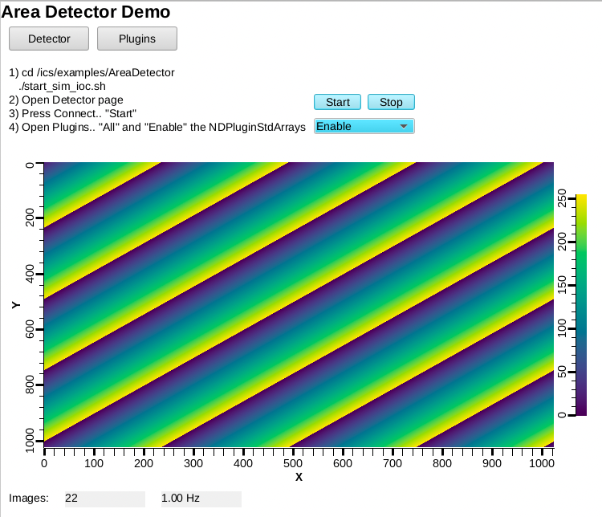
Using ‘ADSimDetector’
Start IOC
  cd /ics/examples/AreaDetector
  ./clear_settings.sh
  ./start_sim_ioc.sh
Open Display
  ﻿css -resource /ics/examples/AreaDetector/0_AreaDetectorDemo.bob
Select “Start” and “Enable”

Slide 9
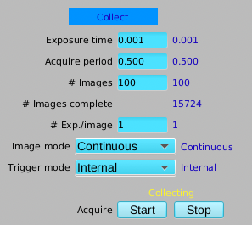
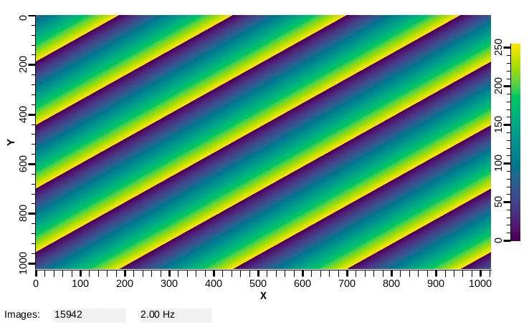
ADSimDetector
Open the “Detector” Page
Under “Collect”,
set the “Acquire Period”
to 0.5
Observe counter for images and rate on main page

Slide 10

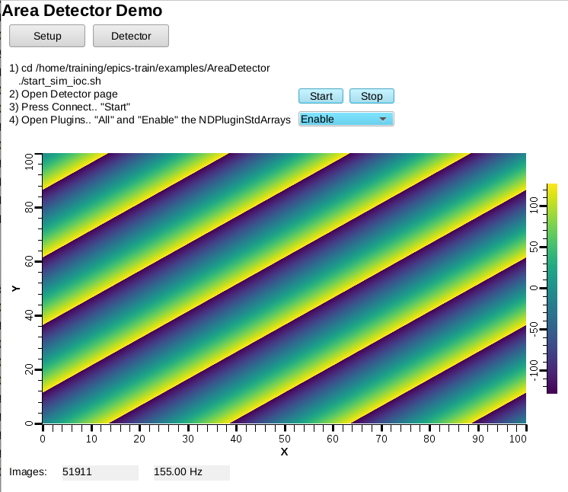
NDPluginStdArrays
Serves image as Channel Access waveform
On Detector,
Plugins, All,
find NDPluginStdArrays
  Port = “SIM1”
  Enable
0_AreaDetectorDemo.bob
shows image
  PV: 13SIM1:image1:ArrayData
  Data Width x Height: 1024 x 1024
  Color Mode: TYPE_MONO
  [x] Unsigned

Slide 11
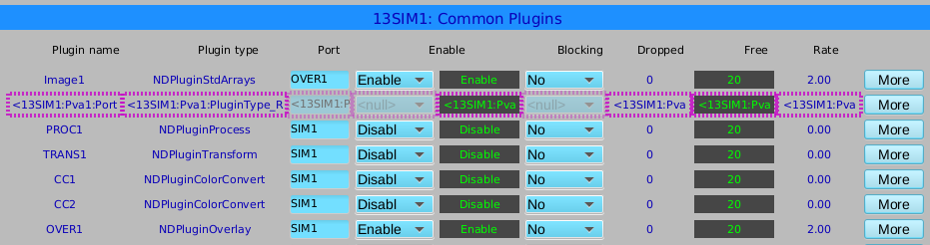
NDPluginOverlay
Adds rectangles, text etc. to image
On Detector, Plugins, All, find NDPluginOverlay “OVER1”
  Set its Port to “SIM1”, Enable
  Change NDPluginStdArrays’s Port to “OVER1”
  Press “More”, select first of the “Individual Overlays”

Slide 12
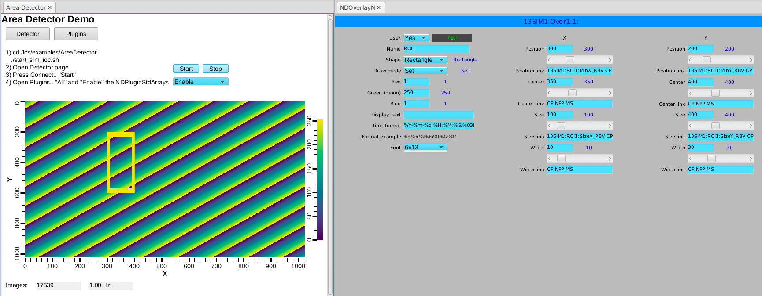
NDPluginOverlay.. Overlay #1
Configure as shown:

Slide 13
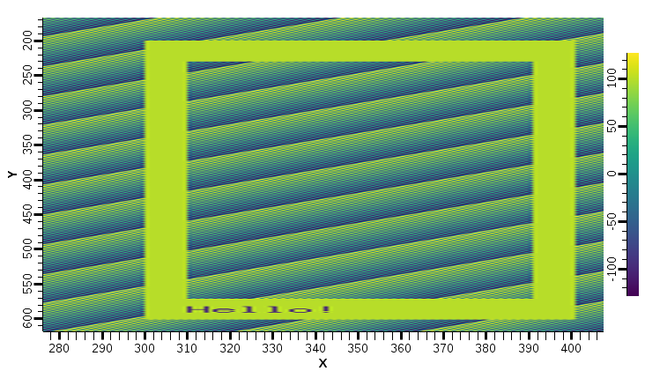
What we did
Area Detector IOC
Image1
Plugins
OVER1
OVER1 offers 8 overlays:
Rectangle
Text “Hello”
…
SIM1
Driver

Slide 14
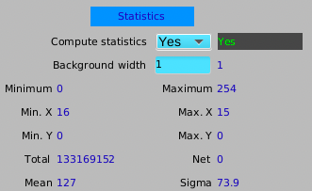
NDPluginStats
Computes min, max intensity etc.
Computes profiles
Advanced image statistics
  Excess Kurtosis (flatness)
  Skewness (symmetry)
  Centroid & sigma
On Detector, Plugins, All,
find NDPluginStats “STATS1”, “More”
  Set its Port to “SIM1”, Enable
  Note how the Statistics show
  min..max of 0..255

Slide 15
NDPluginROI
Performs Region-Of-Interest calculations
  Selects part of image
On Detector, Plugins, All, find NDPluginROI “ROI1”, “More”
  Set its Port to “SIM1”, Enable
  Set X and Y ROI size to 10, so ROI is small 10x10 corner of image
Back in STAT1, change port from “SIM1” to “ROI1”
  Note how the Statistics show a varying min..max as the image data rolls through that ROI

Slide 16
What we did
Area Detector IOC
Image1
STATS1
Plugins
OVER1
ROI1
SIM1
Driver

Slide 17
More Plugins
Process
  Background subtraction, clipping, recursive averaging over N images, ..
Saving images in various formats
  Adding data from PVs as “Attributes”
  PNG, JPEG, TIFF, HDF5, …
Serving NDArray via PVA
  For displays: No need to configure size, data type, …
  For ADPvAccess Driver: Process data on different hosts

Slide 18
NDPluginPVA – Serve PVA ‘Image’
In Plugins, “PVA1”
  Set its Port to “SIM1” or “OVER1”, Enable
PVAccess Tests
  pvlist
  pvinfo 13SIM1:Pva1:Image
  pvget -r 'field(dimension)' 13SIM1:Pva1:Image
In Display (0_AreaDetectorDemoPVA.bob)
  Use “Image” widget
  Set PV
  No need to configure data size, data type

Slide 19
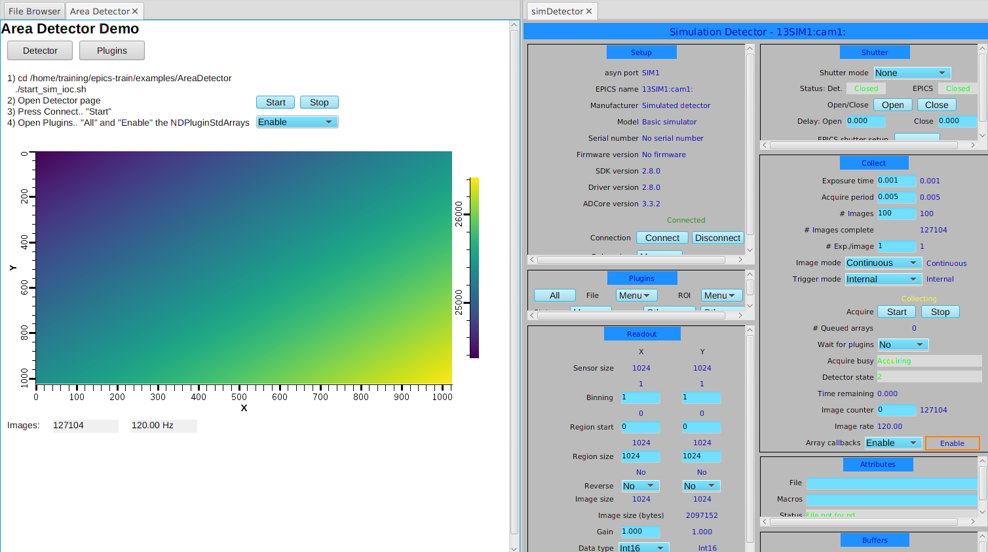
NDPluginPVA – Serve PVA ‘Image’
Display adapts when image size and data type change

Slide 20
Area Detector
Ecosystem for handling
Cameras
Detectors
“Images” in EPICS

